Slide 1
How YouTube Works Behind the Scenes
A Tech Overview for Grade 12 Students

Slide 2



Why Learn About YouTube?
YouTube is one of the biggest tech systems in the world.
Understanding programming, networking, AI, and cloud computing.
Careers: software engineer, data scientist, UI/UX, cloud architect.

Slide 3
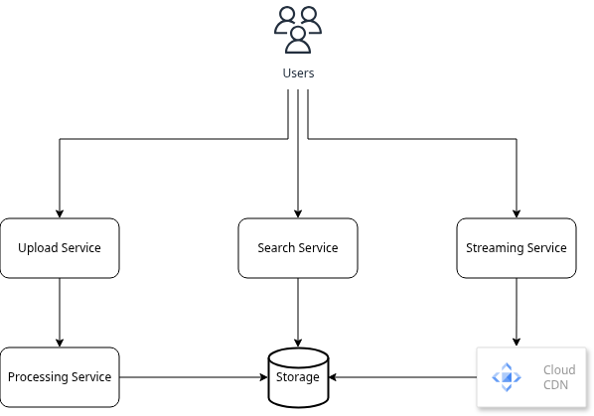
The Big Picture: YouTube Architecture

Slide 4
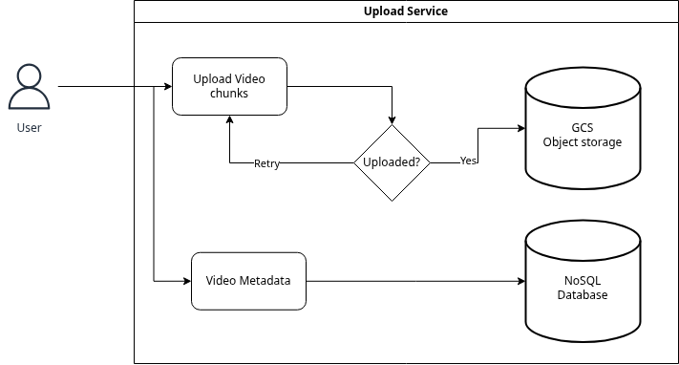
Uploading a Video
User uploads in chunks
Chunks stored temporarily
After upload → video moves into processing

Slide 5
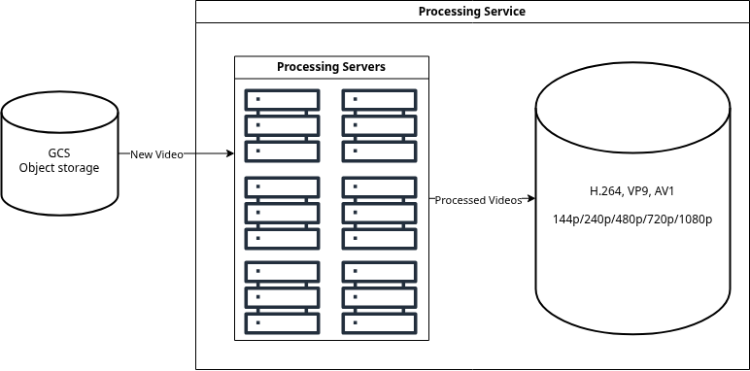
Video Processing (Transcoding)
System converts video into multiple qualities (144p to 4K)
Creates different codecs (H.264, VP9, AV1)
Makes videos work on all devices + connections.

Slide 6


Storing Videos
Videos stored in Google Cloud Storage (GCS)
Metadata stored separately (titles, likes, comments)

Slide 7
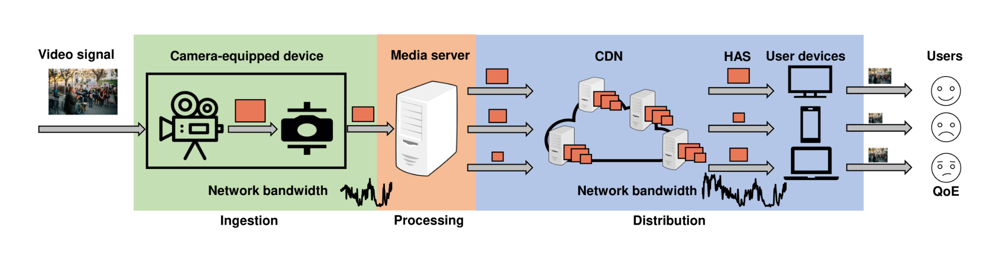
How YouTube Streams Videos to You
Uses adaptive bitrate streaming
Uses protocols: DASH / HLS
Player monitors your internet speed every second.

Slide 8
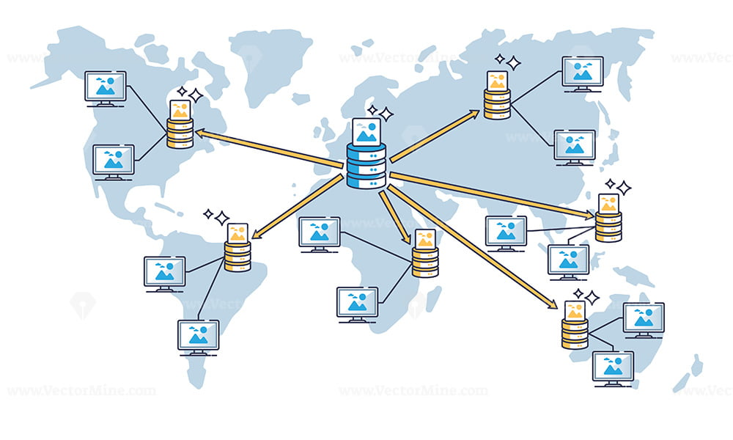
Content Delivery Network (CDN)
YouTube videos cached near you.
Videos from servers in Asia, not the US.

Slide 9
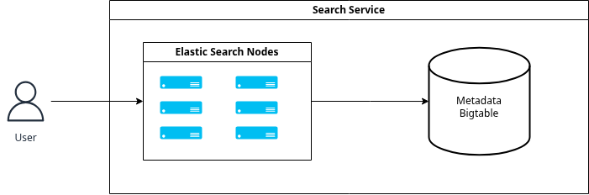
YouTube Search
YouTube uses a search engine (like Google).
Indexes titles, tags, descriptions.
Uses Elasticsearch-like system.

Slide 10
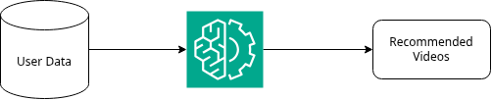
Recommendation System
YouTube recommends videos based on:
Watch history
Likes/subscriptions
Similar users
AI models (Deep Learning)

Slide 11
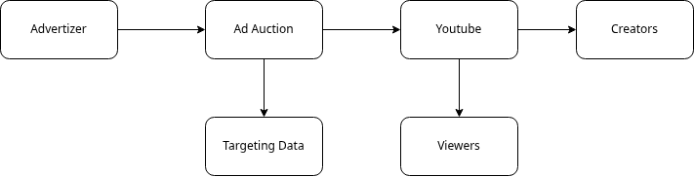
Ads & Monetization
How creators earn money
Types of ads
How YouTube selects which ad to show

Slide 12
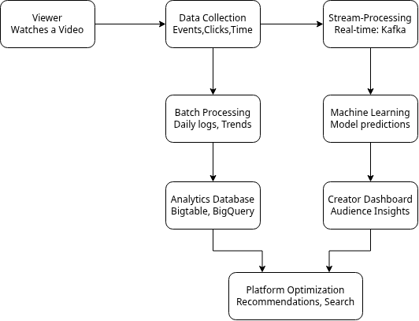
Analytics Behind YouTube
YouTube collects anonymized statistics (watch time, clicks)
Used to improve recommendations & performance
Uses tools like BigQuery, Kafka, etc.

Slide 13








What Technologies Does YouTube Use?
Frontend: JavaScript, HTML
Backend: C++, Java, Go
Databases: Bigtable, Spanner
Cloud: Google Cloud Storage
AI: TensorFlow

Slide 14





Careers That Build YouTube
Software Engineer
Machine Learning Engineer
UI/UX Designer
Data Scientist
Cloud Architect
Software Engineer
Data Scientist

Slide 15
Summary
AI-powered search & recommendations
Scalable backend microservices
Distributed cloud systems
Video processing pipelines
Global CDNs

Slide 16

Questions / Discussion

