Slide 1
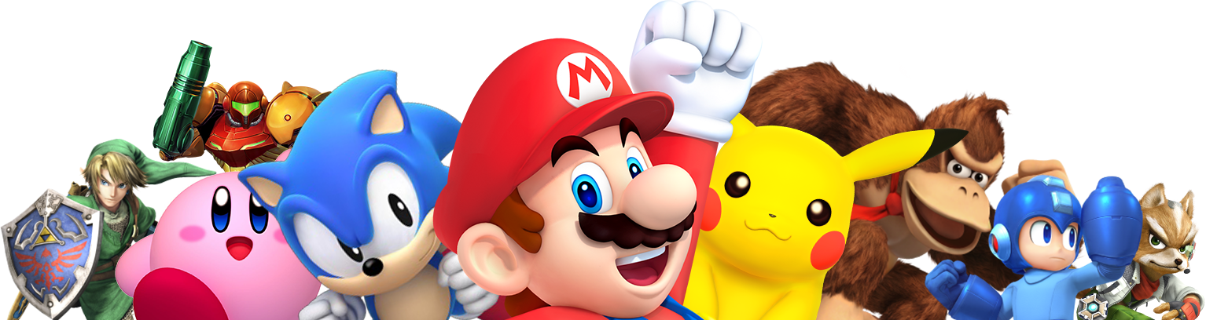
How games work?

Slide 2
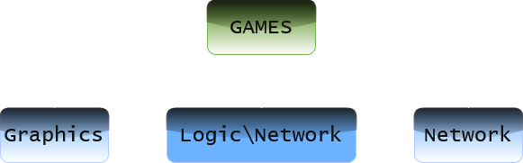
Games have 3 parts:(mainly)

Slide 3
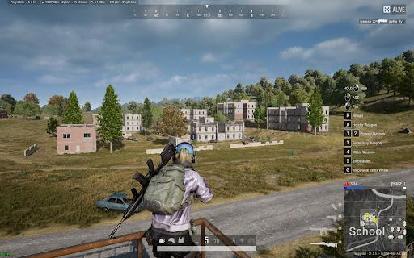
Graphics = Everything you see on the screen.
Characters and skins
Guns and loots
Animations
Smoke effects

Slide 4
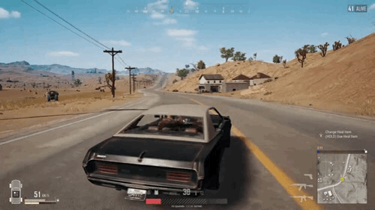
Logic = The brain of the game.
How bullets hit
How the player moves
What happens when you hit the enemy\friend?

Slide 5
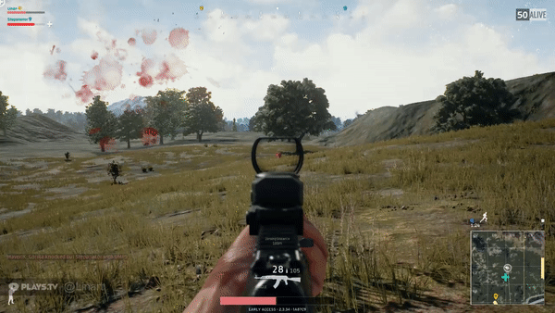
Network = How your device talks to the game server.
When you shoot, your phone sends a message to the server: “I fired a bullet at this location.”
Server checks if it hit and sends updates to all players.

Slide 6

Scratch Demo:

Slide 7
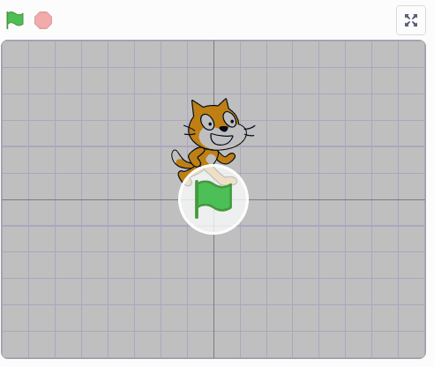
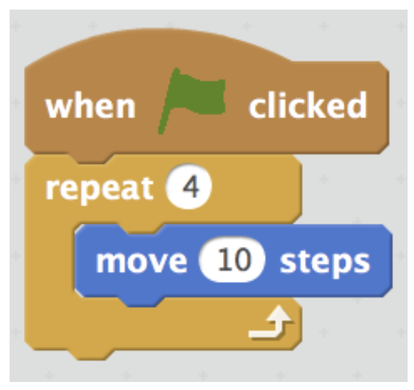
What is Scratch?
Scratch is a free online platform by MIT where you can create games, animations, and interactive stories using drag-and-drop blocks instead of typing code.

Slide 8

Why BSc.CSIT?
CSIT teaches:
Programming
AI
Networking
Graphics
Simulation

Slide 9

THANK YOU :)

