Slide 1

1. Introduction:
Facebook (now under Meta Platforms) is a large-scale social media platform that allows users to connect, share content, communicate, and do business online. Internally, Facebook works by combining user devices, powerful servers, databases, algorithms, and cloud infrastructure to deliver posts, videos, live streams, and marketplace services in real time. This document explains, in a simple and clear way, how Facebook works behind the scenes.

Slide 2

2. User Accounts and Profiles
When a user creates a Facebook account, their basic information (name, email, password hash, profile data) is stored securely in Facebook’s databases.
Each user is assigned a unique user ID.
Profile photos, cover photos, and personal details are linked to this ID.
Login authentication ensures that only the correct user can access the account.
Facebook uses encryption and access control to protect user data.

Slide 3
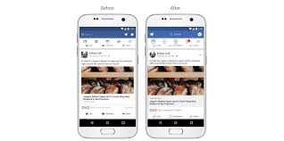
3. Posts and News Feed
3.1 Creating a Post
When a user creates a post (text, image, or video):
The content is sent from the user’s device to Facebook’s
servers.
Text is stored in databases.
Images and videos are stored in distributed storage systems.
3.2 News Feed Algorithm:
Facebook does not show posts randomly. Instead, it uses
algorithms to decide what appears in the News Feed.
The algorithm considers:
Who posted the content
User interactions (likes, comments, shares)
Post type (text, image, video)
Time and relevance
This helps Facebook show content that is most likely to interest each user.

Slide 4
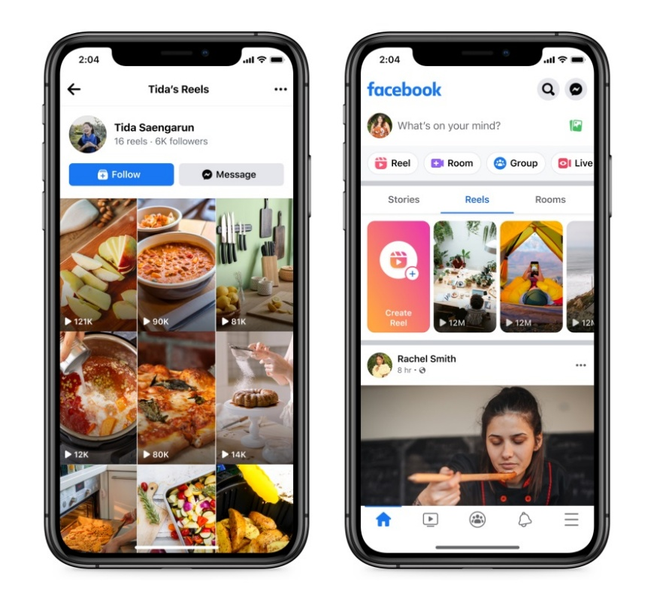
4. Short Videos (Reels)
Facebook Reels are short-form videos designed for fast consumption.
Internally:
Videos are uploaded and compressed into multiple resolutions.
Copies are stored in global data centers.
A recommendation system analyzes user behavior (watch time, likes, skips).
Based on this data, Facebook recommends Reels that match user interests. This is powered by machine learning models.

Slide 5
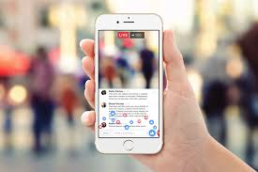
5. Facebook Live
Facebook Live allows users to broadcast video in real time.
How it works:
The live video is captured by the user’s device.
Data is sent continuously to Facebook servers.
The stream is distributed to viewers using content delivery networks (CDNs).
Comments and reactions are processed instantly, creating real-time interaction.

Slide 6
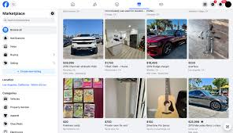
6. Facebook Marketplace
Facebook Marketplace is a platform for buying and selling items.
Internally:
Listings are stored with details such as price, location, and category.
Search and filter systems help users find items nearby.
Messaging is used for buyer–seller communication.
Marketplace uses location data and user preferences to show relevant products.

Slide 7
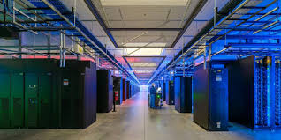
7. Data Storage and Infrastructure
Facebook handles massive amounts of data every day.
Text data is stored in large-scale databases.
Images and videos are stored in distributed file systems.
Data centers are located around the world for speed and reliability.
Facebook uses backups, replication, and load balancing to ensure high availability.

Slide 8
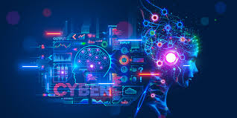
How All of This Is Possible
Facebook’s success is possible due to:
Cloud computing and global data centers
Advanced algorithms and AI models
High-speed networks and CDNs
Scalable software architecture
These technologies allow Facebook to serve billions of users smoothly.

